Slide 1
Attrition & Income modeling For Frito Lay
Reagan Meagher

Slide 2
Inquiries
This project for Frito Lay has four main inquiries:
Create a way to identify the top three factors that contribute to employee turnover
Create a model to classify attrition based on a set of explanatory variables
Create a model to predict monthly income based on a set of explanatory variables
Create visualizations to explore trends about job role specific relationships to a set of variables

Slide 3
Data Set
The data set provided to us by Frito Lay:
Contains 870 observations and 36 explanatory variables or factors
The table below contains a list of all 36 variables:
ID | Age | Attrition | BusinessTravel | DailyRate
Department | DistanceFromHome | Education | EducationField | EmployeeCount
EmployeeNumber | EnvironmentSatisfaction | Gender | HourlyRate | JobInvolvement
JobLevel | JobRole | JobSatisfaction | MaritalStatus | MonthlyIncome
MonthlyRate | NumCompaniesWorked | Over18 | OverTime | PercentSalaryHike
PerformanceRating | RelationshipSatisfaction | StandardHours | StockOptionLevel | TotalWorkingYears
TrainingTimesLastYear | WorkLifeBalance | YearsAtCompany | YearsInCurrentRole | YearsSincePromotion
YearsWithCurrManager

Slide 4
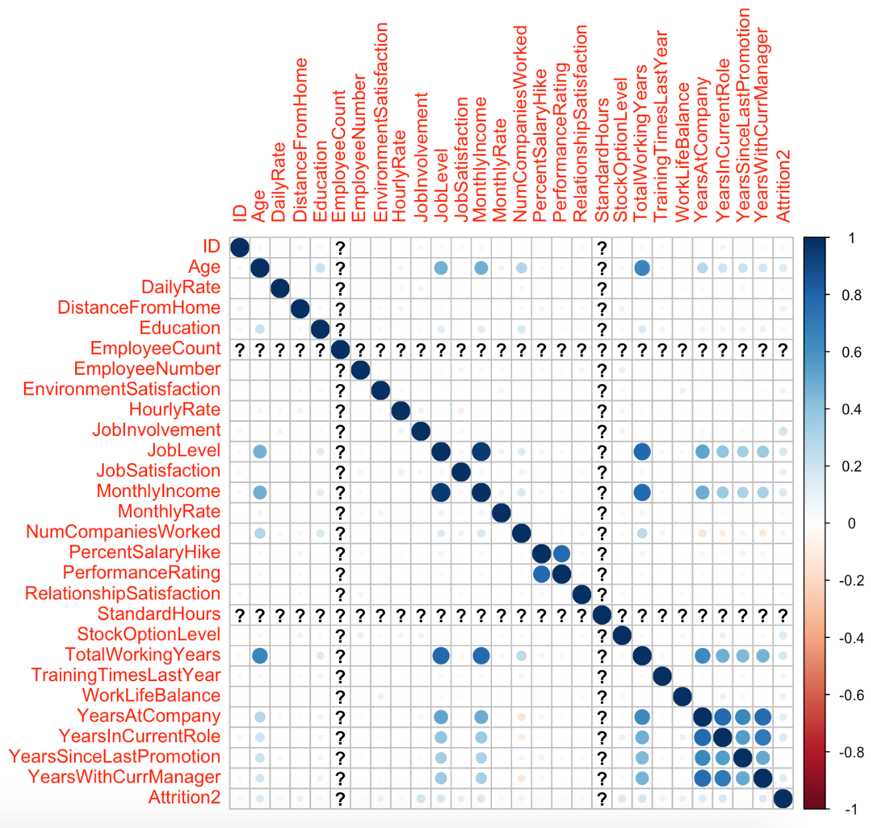
Factors Correlated To Attrition
By building a correlation plot we can see slight correlations between Attrition and the following explanatory variables:
Age
Job Involvement
Job Level
Job Satisfaction
Monthly Income
Stock Option Level
Total Working Years
Years At Company
Years in Current Role,
Years with Current Manager

Slide 5
Other Correlated Variables
From this correlation plot we can also see relationships between other explanatory variables such as:
Total Working Years and Age
Total Working Years and Job Level
Total Working Years and Monthly Income
Monthly Income and Job Level
Performance Rating and Percent Salary Hike.

Slide 6
Models
For this project there are two models that we need create:
Classification Model to Predict
Attrition (Naïve Bayes)
Linear Regression Model to Predict
Monthly Income

Slide 7
Model 1 – Full Data Naïve Bayes – Predicting Attrition
We started with a Naïve Bayes classification model using all explanatory variables except ID and Attrition
The results of this model was a very low specificity, meaning we were getting many false positives
 | Truly No | Truly Yes
Classified As No | 507 | 87
Classified As Yes | 6 | 9
Metric | Value
Accuracy | 84.73%
Sensitivity | 98.83%
Specificity | 9.38%

Slide 8
Model 1 – Subset Data Naïve Bayes – Predicting Attrition
We then moved to a Naïve Bayes classification model using a subset of explanatory variables
The variables used are: Total Working Years, Job Satisfaction, Years At Company, Stock Option Level, Marital Status, Work Life Balance, Number of Companies Worked, Hourly Rate, Years Since Last Promotion, Percent Salary Hike, Over Time, and Years in Current Role.
 | Truly No | Truly Yes
Classified As No | 491 | 33
Classified As Yes | 22 | 63
Metric | Value
Accuracy | 90.97%
Sensitivity | 95.71%
Specificity | 65.62%
We can see that we get improved results from our Naïve Bayes with a subset of explanatory variables:
Accuracy increased by 6.24%
Sensitivity decreased by 3.12%
Specificity increased by 56.24%

Slide 9
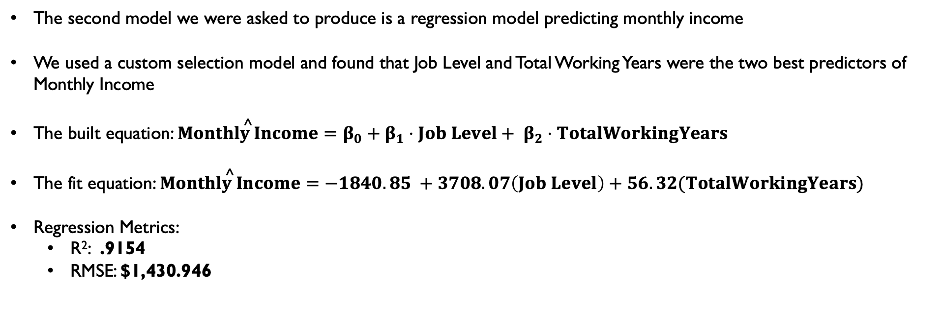
Model 2 – Linear Regression – Predicting Monthly Income
The second model we were asked to produce is a regression model predicting monthly income
We used a custom selection model and found that Job Level and Total Working Years were the two best predictors of Monthly Income
The built equation: $\overset{^}{Monthly Income}=β_{0}+β_{1}⋅Job Level+ β_{2}⋅TotalWorkingYears$
The fit equation: $\overset{^}{Monthly Income}=−1840.85 +3708.07\left(Job Level\right)+56.32(TotalWorkingYears)$
Regression Metrics:
R²: .9154
RMSE: $1,430.946

Slide 10
Job Role Trends
In each Job Role, you can only move up through so many Job Levels before needing to switch roles
Managers & Directors earn the highest income
There are a high percentage of Sales Executives with low Job Satisfaction
About 33% of the company has low Job Satisfaction (1 or 2)

Slide 11
Conclusions
We can see that there are many factors that influence attrition
We have a model that can successfully classify attrition with a 90.97% accuracy
We have a model that can predict Monthly Income
We can see that within Frito Lay Job Role plays a big factor in Monthly Income and Job Satisfaction

